Slide 1


Towards Big Graph Search:
Challenges & Techniques
马 帅
北京大数据与脑及智能高精尖中心 软件开发环境国家重点实验室

Slide 2
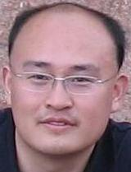
个人简介
北京航空航天大学计算机学院教授、博士生导师；中国计算机学会数据库专业委员会委员，大数据专家委员会委员。
2011年作为海外优秀中青年人才加入北京航空航天大学计算机学院软件开发环境国家重点实验，并特聘为教授。
获得了北京大学(2004)和英国爱丁堡大学 (2011)的两个博士学位。英国爱丁堡大学博士后，并曾在美国贝尔实验室总部实习，在微软亚洲研究院访问。
Homepage: http://mashuai.buaa.edu.cn
Email: mashuai@buaa.edu.cn
Address: Room G1122,
New Main Building,
Beihang University

Slide 3




国家重点基础研究发展计划
网络信息空间大数据计算的基础研究(2014-2018)
Chief Scientist: Prof. Jinpeng Huai.
8 institutes involved
Focus on “computing theory and practice on Big Data”
http://cnbigdata.org/

Slide 4


北京市大数据科学与脑机智能创新中心
2015年，北京市首批北京高校高精尖创新中心
引领未来数据科学与计算智能的研究与应用方向
加速计算科学、数据科学与脑科学的交叉研究
促进高效智能的下一代计算与数据分析技术创新
通过以数据为中心的智能机器、系统及应用改变未来
Notes:
认定了13个

Slide 5


研究方向与机构设置
瓶颈1：计算的有效性遇到障碍
计算的有效性：
认识数据的内在特征，复杂网络、数学（统计）方法
瓶颈2：能耗成为突出问题
随着规模增大，调度复杂，计算系统功耗问题日益突出
传统存算分离的结构，产生大量的数据搬移开销
传统的计算和存储器件“功耗”不友好
瓶颈3：学习效率和灵活性
学习效率：需要大量的输入数据及标定数据，学习效率低
灵活性：普遍缺乏“类比、联想”等学习功能
数据科学与计算智能
数据工程与
脑机系统
新型计算技术与系统
认知机理与仿真
http://www.bdbc.org.cn/

Slide 6

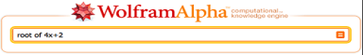
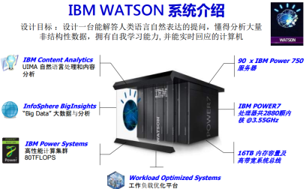
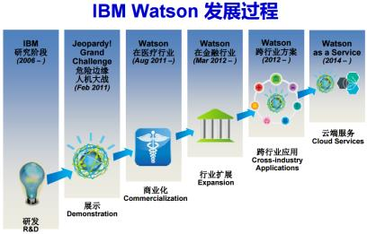
大数据的研究与应用：取得重大突破
过去5年大数据的研究，已经产生了重大突破，并在部分领域取得良好的应用
计算基础：大规模云计算、大规模深度学习
感知处理的角度：大规模深度学习，imageNet
知识组织与管理角度：大规模知识图谱
基于数据产生知识的问答系统与个人辅助系统
Watson DeepQA：智能搜索→知识引擎
Apple Siri & Wolfram Alpha
Watson和Wolfram|Alpha的成功说明：AI可以用一个纯粹的计算系统(交互+计算)实现

Slide 7
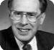

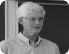

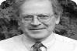

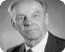



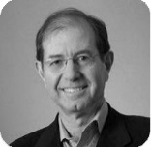



问题：是否有坚实的理论基础
（大）数据科学是否能真的成为一种“科学”？
其中一个可能性：计算问题、复杂性与算法
计算问题是计算机科学的本质问题，而算法是一切计算问题的核心
算法
G=F(x)
数据
John E Hopcroft
Robert Tarjan
(1986）
Stephen Cook
（1982）
Donald Knuth
（1974）
70年代前 | 算法研究
70年代 | 确定性多项式时间算法 发现NP困难性
80年代 | 随机化算法 随机性能加速算法
90年代 | 近似算法 后期发现近似困难性
Leslie Valiant
（2010）
Manuel Blum
（1995）
Juris Hartmanis ,
Richard Edwin Stearns
（1993）
21世纪－大数据时代：计算复杂度与算法理论是否有新的理论问题和新方法？
Shafi Goldwasser
Silvio Micali
（2012）

Slide 8
回答“可计算”问题(1)
G=F(x)
任务1：易解类复杂性理论
如何定义大数据易解类？
计算问题
如何判断给定查询是否为易解？
不可判定问题
可判定问题
NP and beyond
多项式易解类
多项式易解类
难解问题
易解问题
(多项式易解类)
非大数据
易解类
大数据易解类
不可近
似问题
可近似
问题
非大数据 易解类
大数据 易解类
若硬盘读取速度6Gbps,log(|D|)时间扫描
1PB数据，只需15秒(v.s.1.99天）
1EB数据，只需18秒(v.s.5.28年)
大数据下，考虑 x 与F 的耦合
传统认为易解问题 可能成为“难解”问题！
近似算法
（多项式算法）
易解类查询:在大数据上是可行的！
针对传统易解成为实际难解问题，提出大数据易解类复杂性理论；发表在数据库领域顶级会议VLDB ,审稿专家认为:“The paper is going to start a new line of research and products ”

Slide 9
回答“可计算”问题(2)
G=F(x)
任务2：数据驱动的近似算法理论
什么是大数据计算中可近似问题？
计算问题
如何衡量数据量与近似效果的关系?
不可判定问题
可判定问题
NP and beyond
多项式易解类
多项式易解类
难解问题
易解问题
(多项式易解类)
非大数据
易解类
大数据易解类
不可近
似问题
可近似
问题
非大数据 易解类
大数据 易解类
大数据下，传统近似方法局限性
近似算法
（多项式算法）
大数据可近似问题
⊕
大数据不可近似问题
近似的新挑战：
F →F’
X →X’

Slide 10
回答“可计算”问题(3)
G=F(x)
任务3：大数据高效算法理论
如何设计更有效的算法？
计算问题
如何以“以局部观全局”？
不可判定问题
可判定问题
NP and beyond
多项式易解类
多项式易解类
难解问题
易解问题
(多项式易解类)
非大数据
易解类
大数据易解类
不可近
似问题
可近似
问题
非大数据 易解类
大数据 易解类
针对大数据非易解类问题，提出高效算法理论与算法！
近似算法
（多项式算法）

Slide 11
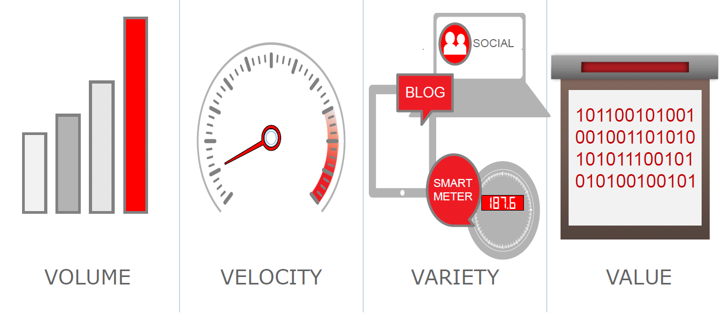

Big Graph, e.g., Social Networks
Big volume: a balance between search efficiency and accuracy
Frequent changes: incorporate dynamic and temporal features
Noise & uncertainty: improve data quality, alleviate side effects
Notes:
《福布斯》日前评选出十位最年轻的亿万富翁，26岁的马克-扎克伯格以69亿美元的身价排在首位，他也因此成为世界上最年轻的亿万富翁。

Slide 12

The FAE Challenge
Big dynamic and uncertain graphs:
F: how to provide a Friendly search interface?
A: how to search “information” more Accurately?
E: how to search “information” more Efficiently?
Shuai Ma, Jia Li, Chunming Hu, Xuelian Lin, and Jinpeng Huai. Big Graph Search: Challenges and Techniques. Frontiers of Computer Science, 2016. (invited)

Slide 13
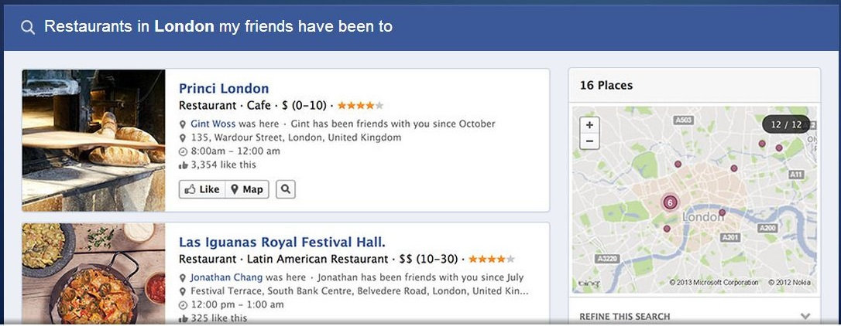
Friendliness
How to provide a friendly interface for graph search?
key words based searches are friendly
directly input query graphs by users are very unfriendly
implicitly express query graphs in a convenient way
e.g., Facebook uses a simplified NLP interface
Facebook Graph Search

Slide 14





E.g., Search Influential Event Organizers
Keywords based search of K influential event organizers from online social networks
Incorporate keywords based search
Incorporate event influence propagation
Provide an approximation algorithm - (1/2 – ξ)
Tom,
“Machine Learning”, “Data Mining”
Bob
“Psychology”, “Sociology”
Facebook Graph Search
Example Query Q:
K = 2
Q = {Psychology,
Sociology,
Data mining }
……
……
Bill,
“NLP”, “Machine Learning”
Sam,
“Database”, “Data Mining”
……
[11] Kaiyu Feng, Gao Cong, Sourav S. Bhowmick, Shuai Ma: In search of influential event organizers in online social networks. SIGMOD 2014.

Slide 15

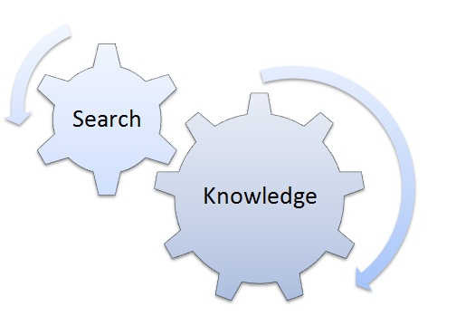
Accuracy
How to search “information” more accurately?
User intension understanding (combine user behavior features)
Incorporate Knowledge Graph
Query transformation based on knowledge graph and user intension
Mobile Networks
Search super markets/ restaurants near Hotel Arthur
at Beijing vs. at Helsinki
at Helsinki: on Sunday vs. NOT
LUMI Supermarket - Flagship Boutique (close on Sunday)
at Helsinki: at noon vs at midnight
K-supermarket Kaisaniemi (7am~9pm)
Knowledge Graph
Notes:
移动互联网的发展：
在Android2.3 gingerbread系统中，google提供了11种传感器: 加速度、磁力、方向、陀螺仪、光线感应、压力、温度、接近、重力、线性加速度、旋转矢量

Slide 16

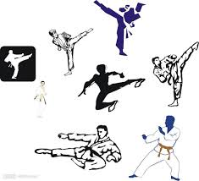
Efficiency
How to search “information” more efficiently?
Query approximation techniques
Data approximation techniques
Inexact
近似性
Incremental
增量性
Inductive
归纳性
Big Data Computation (3I)
R = Q(D)
天下武功 唯快不破

Slide 17
Query Techniques for Big Graph Search
R = Q(D)

Slide 18
Query Approximation Techniques
Main idea: For a class Q of queries with a high computational complexity, find another class Q’ of queries that has a lower computational complexity without loss of quality or with a bounded loss of quality.
approximation
Q(D)
Q’(D)
Challenge: balancing accuracy and computational complexity!

Slide 19
(1) E.g., Strong Simulation
approximation
Subgraph Isomorphism
(NP-Complete)
Strong Simulation
(O(n³))
Subgraph Isomorphism: Pattern graph Q, subgraph G_{s} of data graph G
Q matches G_{s} if there exists a bijective function f: V_{Q}→ V_{Gs} such that
for each node u in Q, u and f(u) have the same label
An edge (u, u‘) in Q if and only if (f(u), f(u')) is an edge in G_{s}
Q matches G, via subgraph isomorphsim, if there is such a subraph Gs
Goodness：Keep exact structure topology between Q and G_{s}
Badness：NP-complete; may return exponential many matched subgraphs; In certain scenarios, too restrictive to find matches
Shuai Ma, Yang Cao, Wenfei Fan, Jinpeng Huai, and Tianyu Wo. Strong Simulation: Capturing Topology in Graph Pattern Matching. TODS 2014.
Shuai Ma, Yang Cao, Wenfei Fan, Jinpeng Huai, and Tianyu Wo, Capturing Topology in Graph Pattern Matching. VLDB 2012.

Slide 20
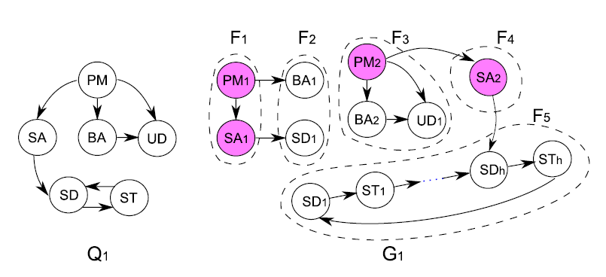

(1) E.g., Strong Simulation
Set up a team to develop a new software product
Strong simulation returns F3, F4 and F5;
Subgraph isomorphism returns empty!
Subgraph isomorphism is too strict for emerging applications!

Slide 21

(1) E.g., Strong Simulation
Terrorist Collaboration Network
“Those who were trained to fly didn’t know the others. One group of people did not know the other group.” (Osama Bin Laden, 2001)
Build upon (revised) strong simulation to aid the detection of homegrown violent extremists (HVEs) who seek to commit acts of terrorism in the United States and abroad, Colorado State University, Benjamin W. K. Hung, Anura P. Jayasumana: Investigative simulation: Towards utilizing graph pattern matching for investigative search. ASONAM 2016.

Slide 22
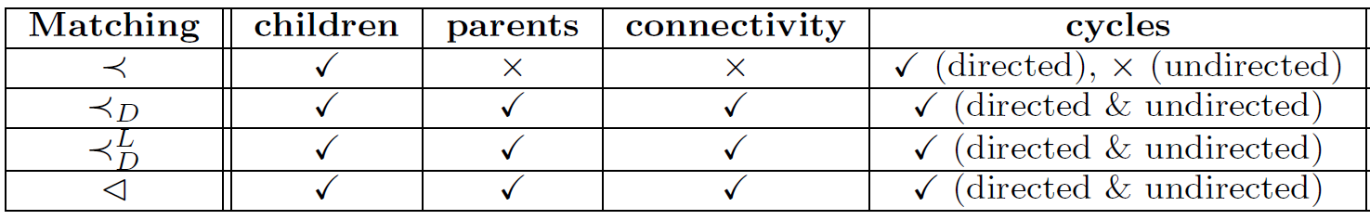
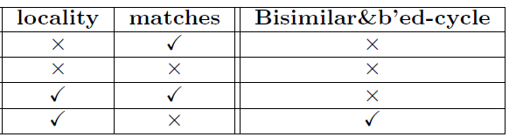
(1) E.g., Strong Simulation
Subgraph
Isomorphism
(NP-Complete)
Strong
Simulation
Dual
Simulation
Graph
Simulation
(O(n³))
Preserve 70-80% subgraph isomorphism & 100 times faster!

Slide 23
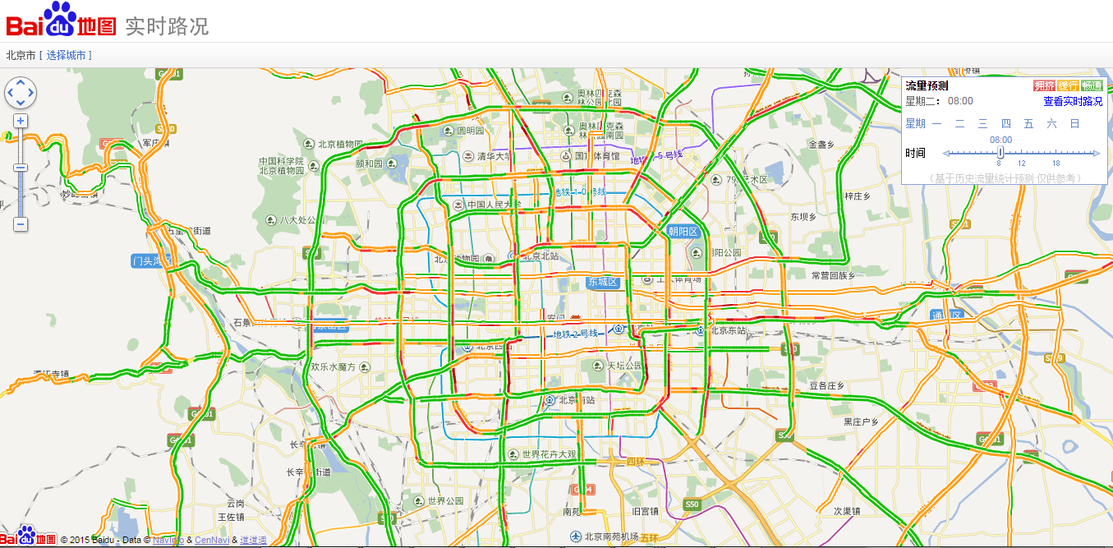
(2) E.g., Temporal Dense Subgraphs

Slide 24
(2) E.g., Temporal Dense Subgraphs
Filter-and-Verification methods:
Data Driven Query Approximation methods:
Choose k (a small constant, e.g., 10 or 15)
Experimental results (with the state of the art solution ^{[Bogdanov et al. 2011]})
10⁴ | 10⁵ | 10⁶ | ··· | 10⁸
5×10² | 5×10³ | 5×10⁴ |  | 5×10⁶
95% are filtered
10⁴ | 10⁵ | 10⁶ | ··· | 10⁸
k | k | k |  | k
 | Accuracy | Efficiency
BEIJING DATA | 100.28% | 2980 times faster
SYNTHETIC DATA | 99.84% | 1,079 times faster
P. Bogdanov, M. Mongiov, and A. K. Singh. Mining heavy subgraphs in time-evolving networks. In ICDM, 2011.
Haixing Huang, Jinghe Song, Xuelian Lin, Shuai Ma, Jinpeng Huai, TGraph: A Temporal Graph Data Management System (demo), CIKM 2016.
Shuai Ma, Renjun Hu, Luoshu Wang, Xuelian Lin, Jinpeng Huai, Fast Computation of Temporal Dense Subgraphs, ICDE 2017

Slide 25


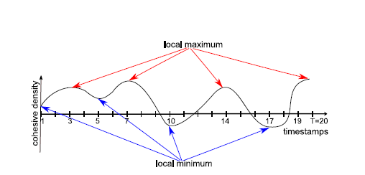
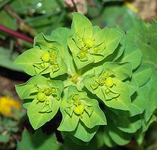

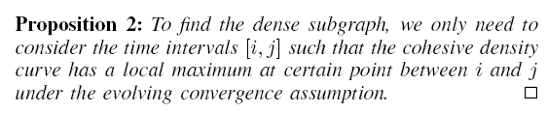
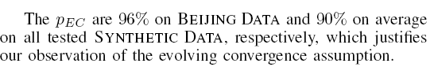
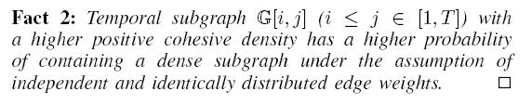
(2) E.g., Temporal Dense Subgraphs
In evolutionary biology, convergent evolution is the process whereby organisms not closely related (not monophyletic), independently evolve similar traits as a result of having to adapt to similar environments or ecological niches.
Evolving convergence assumption
Shuai Ma, Renjun Hu, Luoshu Wang, Xuelian Lin, Jinpeng Huai, Fast Computation of Temporal Dense Subgraphs, ICDE 2017
Notes:
Example: Two succulent plant genera, Euphorbiaand Astrophytum, are only distantly related, but the species within each have independently converged on a similar body form
大戟属，又称翡翠塔属，是大戟科植物的一个属，包括了2160多种不同种类的植物，当中有些比较常见的，例如：一品红、灯台草等。大戟属植物是现时地球上其中一种生长范围极广的植物种属，主要在非洲及美洲的热带及亚热带地区生长，但在温带亦有发现。生长年期有一年生或多年生，有草本、木本灌木及乔木，而且都有树液。
仙人掌

Slide 26
Data Techniques for Big Graph Search
R = Q(D)

Slide 27
Data Approximation Techniques
Main idea: For a class Q of queries on data D, transform D to smaller data D’ that can be processed efficiently without loss of quality or with a bounded loss of quality.
approximation
Q(D)
Q (D’)
Pareto principle: for many events, roughly 80% of the effects come from 20% of the causes
D = HARD(D) + SOFT(D)
×
Challenge: balancing accuracy and computational complexity!

Slide 28
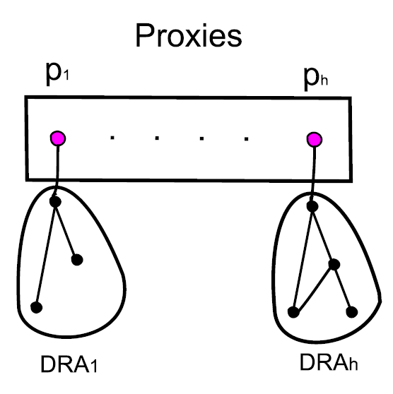
(1) E.g., Shortest Paths/Distances
For weighted undirected graphs, we propose a notion of “proxies”
Each proxy represents the nodes in its DRA (non-overlapping for all proxies)
Proxies can be computed in O(n) time
Key property: Given nodes u,v in G, proxies u_{p},v_{p}, then:
(1) path(u, v) = path(u, u_{p}) + path(u_{p}, v_{p}) + path(v_{p}, v)
(2) dist(u, v) = dist(u, u_{p}) + dist(u_{p}, v_{p}) + dist(v_{p}, v)
On Real-life road and social networks, graphs are reduced by 1/3!
A light-weight general data reduction technique for shortest paths/distances!
Shuai Ma, Kaiyu Feng, Jianxin Li, Haixun Wang, Gao Cong, and Jinpeng Huai, Proxies for Shortest Path and Distance Queries. TKDE 2016.
Shuai Ma, Kaiyu Feng, Jianxin Li, Haixun Wang, Gao Cong, and Jinpeng Huai, Proxies for Shortest Path and Distance Queries. ICDE 2017 (TKDE Extended Abstract).

Slide 29
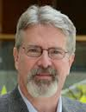
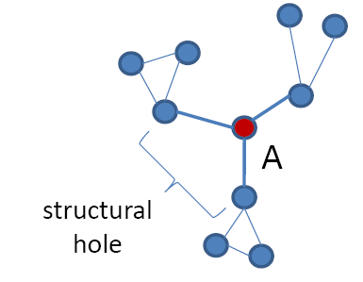
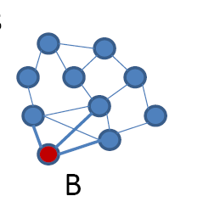
(2) E.g., Network Anomaly
Structural hole theory ^{[Burt 1992,2004]}
Theory of social capital
Lack of connection between two nodes that is bridged by a broker
Prof. Ronald S. Burt
University of Chicago
Fellow, American Academy of Arts and Sciences (1993)
Fellow, Center for Advanced Study in the Behavioral Sciences(1984)
Bridge counts: a simple and intuitive measure of structural holes in a network.
Node A (brokers) is more likely to get novel information than node B, even though they have the same number of links.
Burt, Ronald S. (1992). Structural holes: the social structure of competition. Harvard University Press.
Burt, Ronald S. (2004). Structural Holes and Good Ideas. American Journal of Sociology 110 (2): 349–399.

Slide 30
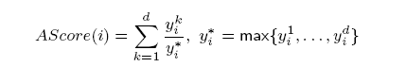
(2) E.g., Network Anomaly
Structural hole theory (1992)
Theory of social capital
Lack of connection between two nodes that is bridged by a broker
Prof. Ronald S. Burt
University of Chicago
Fellow, American Academy of Arts and Sciences (1993)
Fellow, Center for Advanced Study in the Behavioral Sciences(1984)
How to detect social brokers?
A formal quantitative definition is needed in the first place!
定义: Those nodes that connect to a number of diverse influential communities.
Renjun Hu, Charu C. Aggarwal, Shuai Ma, Jinpeng Huai: An Embedding Approach to Anomaly Detection. ICDE 2016.
Notes:
With a fixed number of training samples, the predictive power reduces as the dimensionality increases, and this is known as the Hughes effect^{[3]} or Hughes phenomenon(named after Gordon F. Hughes)

Slide 31
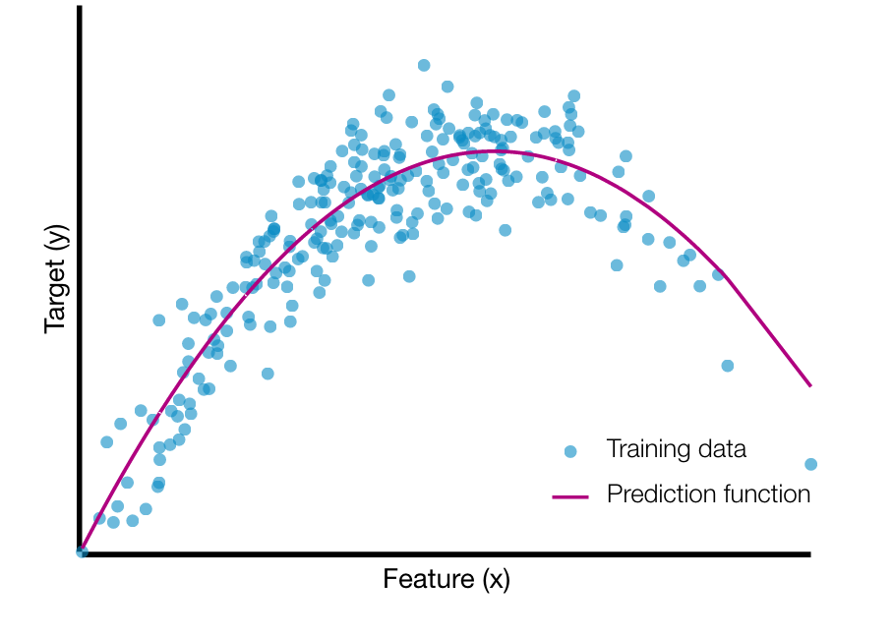
(2) E.g., Network Anomaly
A graph embedding approach
Two-in-One
Graphs are represented as matries
Data Approximation (k + α reduction)
High storage cost of matrix
Transform a n*d matrix to a n*k one,
n: # of nodes, d: # of communities
k: average node degree, k<<d
The ith entry (feature ) in a d-dimension vector is the weight that the node belongs to community i
(Gordon) Hughes Effect
Our data approximation technique (k + α reduction) improves (1%, F1) on accuracy and 25% on efficiency!
Renjun Hu, Charu C. Aggarwal, Shuai Ma, Jinpeng Huai: An Embedding Approach to Anomaly Detection. ICDE 2016.
Notes:
With a fixed number of training samples, the predictive power reduces as the dimensionality increases, and this is known as the Hughes effect^{[3]} or Hughes phenomenon(named after Gordon F. Hughes)
Gordon Hughes earned his PhD degree at Cal Tech, and began his technology career at Xerox Research, later serving as the Senior Director of Recording Technology at Seagate, in its early years. He is now a research scientist at the Center for Memory and Recording Research at the University of California San Diego.
In 2001, he was named Fellow of the IEEE for "contributions to magnetic recording physics and for pioneering work in thin film disk media".
“Comments on the mean accuracy of statistical pattern recognizers'ce”, K. Abend, T.J. Harley Jr., B. Chandrasekaran, T.J. Harley, and G.F. Hughes, IEEE Transactions on Information Theory, Vol.IT-15, No. 3, (May 1969), pp. 420-423

Slide 32
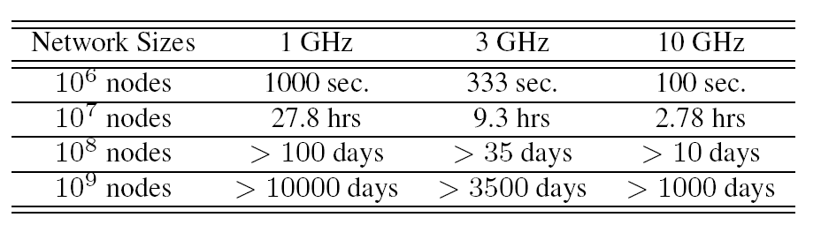
(2) E.g., Network Link Prediction
Link Prediction
A network with n nodes，O(n²) possible links
CPU speeds: xGHz/s, and assume that a single machine cycle could deal with a node pair.
Most link prediction algorithms only predict a subset of the possible links, not all possible links, such as [Dashun et al. 2011, Chungmok et al. 2014].
Dashun Wang, Dino Pedreschi, Chaoming Song, Fosca Giannotti, Albert-László Barabási: Human mobility, social ties, and link prediction. KDD 2011.
Chungmok Lee, Minh Pham, Norman Kim, Myong K. Jeong, Dennis K. J. Lin, Wanpracha Art Chaovalitwongse. A novel link prediction approach for scale-free networks. WWW 2014.

Slide 33
(2) E.g., Network Link Prediction
sample₁
Ensemble
Direct Non-negative Matrix Factorization
Low efficiency
The sparser the data, the worse the prediction
Data approximation technique (Ensemble Enabled Sampling)
Sampling must assure a coverage on O(n²) possible links
Link prediction characteristics (triangles)
Ensemble: the predicted value of a link is the maximum among all ensembles
Data
．．．
max
sample_{n}
Ensemble
Framework
Small data | Accuracy | Big data | Efficiency
YouTube | +18% | Friendster | 31 times faster
Wikipedia | +16% | Twitter | 21 times faster
Improves both accuracy and efficiency!
Liang Duan, Charu Aggarwal, Shuai Ma, Renjun Hu, and Jinpeng Huai, Scaling up Link Prediction with Ensembles, WSDM 2016 - Big Data Algorithms Session.

Slide 34
Other Query and Data Techniques
Q(D₁)
Distributed algorithms:
Q(D)
Q(D_{i})
Q(D_{n})
Incremental Computation:
Incremental computation
Q(D + Δ)
Q(D) + Q(Δ)
Known results
compression
Data Compression:
Q(D)
Q(D’)
partitioning
Data Partition:
Q(D)
Q(D₁) + … + Q(D_{n})

Slide 35
大数据技术的应用案例
BDA

Slide 36
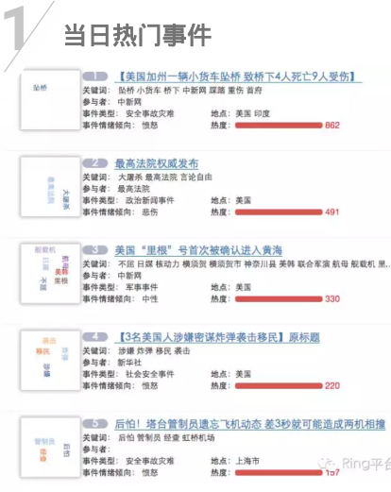

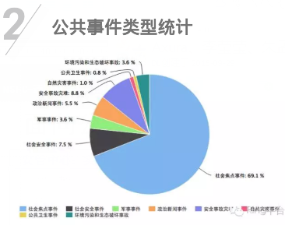
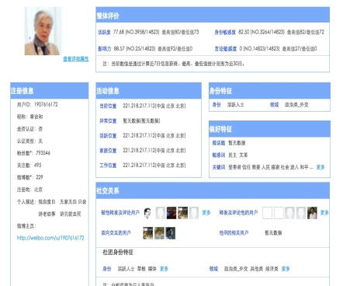
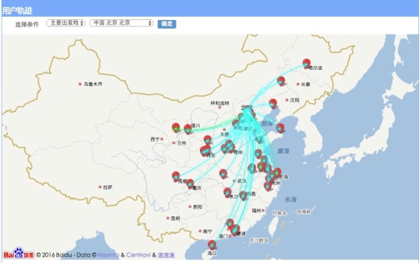
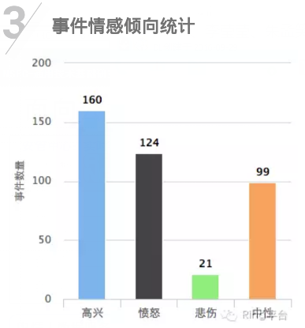
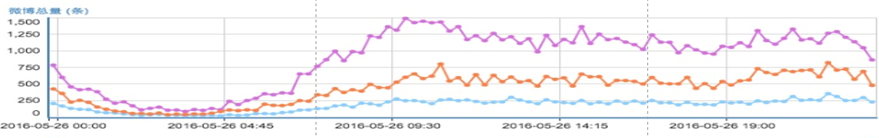
如一：面向公共事件的示范应用
安管中心：实时事件检测与分析系统
安管中心：微博人物画像系统
个人多维画像
群体迁徙分析
事件检测
事件分析
地域迁徙图
地域迁徙图
群体情绪监测
舆情大数据服务：已被国家信息安全管理中心采用，建立Ring微信公众号
研究工作：异质大数据获取、建模与深度分析，异构大数据存储与多模态计算，复杂系统敏捷定制，事件分析与预测。
Notes:
实时事件检测与分析系统Ring 事件检测，事件演化，热点词排行榜、微博统计(统计每天的微博数量、某类型微博数量、微博类型所占比例圆饼图)、人物事件库、用户分析（用户的相关微博、社交圈、核心朋友圈、标签）
微博人物画像系统--信息安全管理中心（吴老师） 个人多维画像、社交分析（从图上看是根某用户相关的社交用户）、群体迁徙分析(没看明白)、群体情绪监测

Slide 37


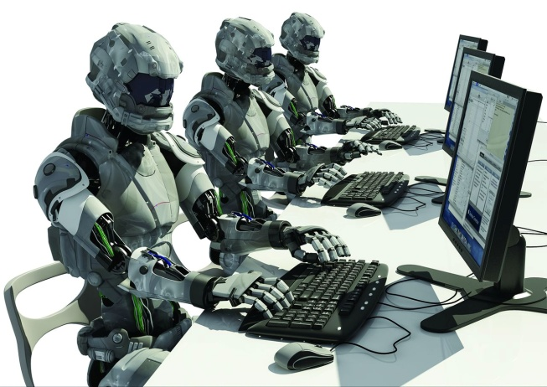
如二：人类行为预测
Prediction is now a developing science
Success seems to be achieved most consistently when questions are tackled in multidisciplinary efforts that join human understanding of context with algorithmic capacity to handle terabytes of data - Special Issue: Prediction, Science, Feb. 3, 2017.
2016年美国大选预测失败原因？
Twitter机器人、雇佣军
Shy Trump voter理论: 支持者趋向于保持沉默
人类行为预测是下一个前沿：
更多的数据≠更好的预测：噪音的存在
罕见事件、行为动态变化
IoT的涌现导致多种异构数据爆炸
Notes:
预测是一门发展中的科学，需要均衡机器学习等人工智能方法和人的因素

Slide 38


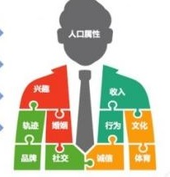


如二：基于微博数据的群体行为预测
用户爬取
特征提取
模型验证
建立模型
用户转发、发布、回复行为模型
创建虚拟用户、
可视化展示
目标：本文以爬取的微博数据为基础，对微博用户进行特征提取，利用提取的用户特征进行聚类，得到统计特征差别明显的不同用户群体，针对不同群体，分析用户行为的影响因素，探究微博用户行为机理。
主要衡量指标：行为建模准确度

Slide 39




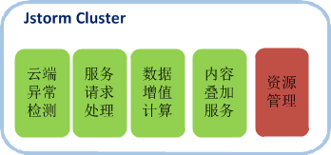

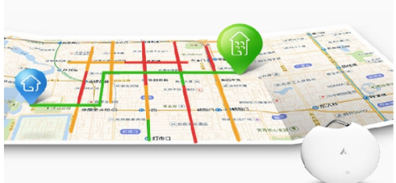
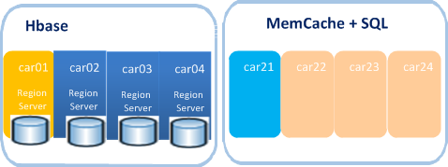
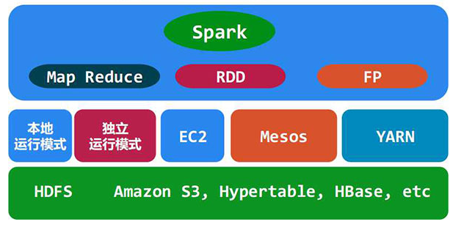
如三：实时流式大数据处理平台
车网监控平台
资源管控平台
公众服务平台
运营托管平台
开放数据平台
移动端交互与数据采集
第三方应用接入
实时流式处理
分布式消息队列
应用数据总线
离线数据挖掘
时空大数据存储管理

Slide 40
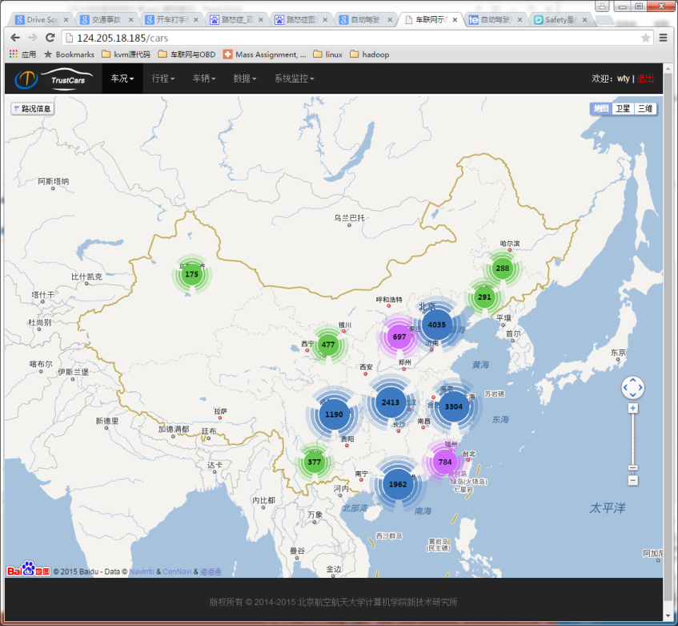
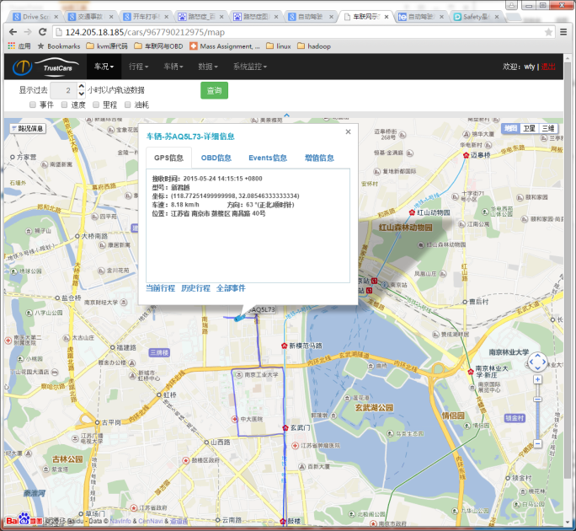
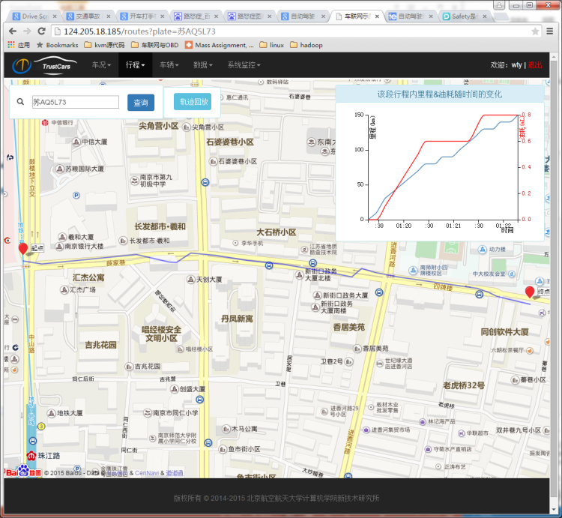
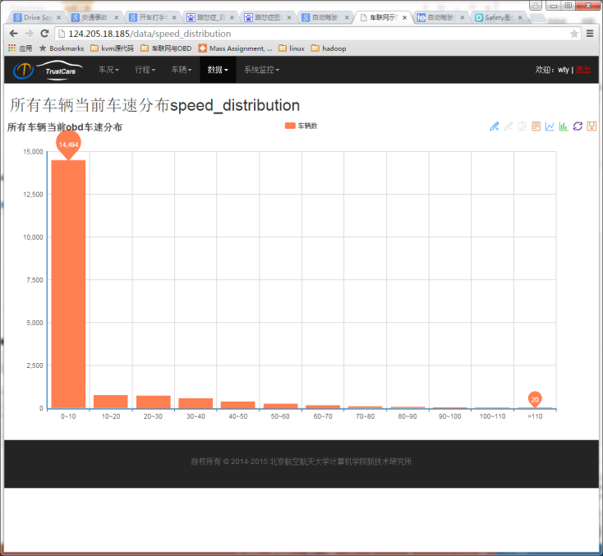
如三：实时流式大数据处理平台
车辆运营态势
单个车辆状态实时跟踪
历史运营分析
线路、里程、油耗、行为
行程实时切分与速度分析
数据质量分析与系统状态监控

Slide 41
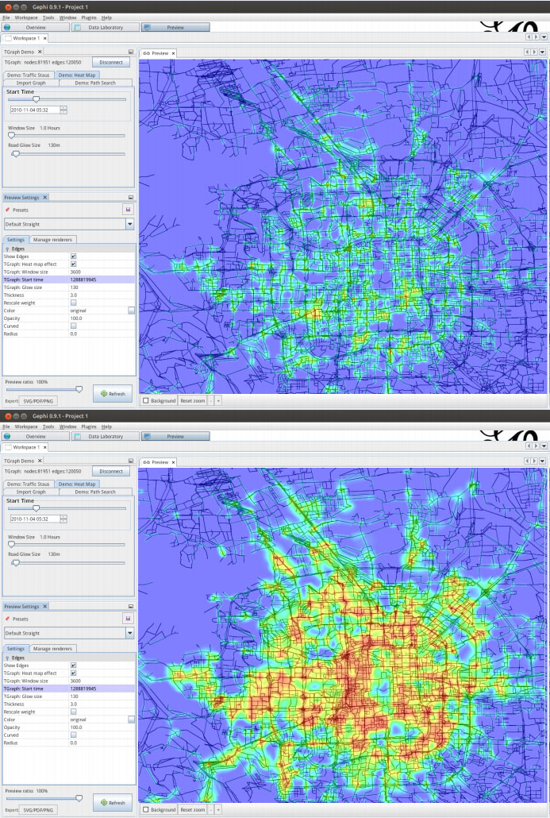
如四：TGraph时态图数据管理系统

Slide 42

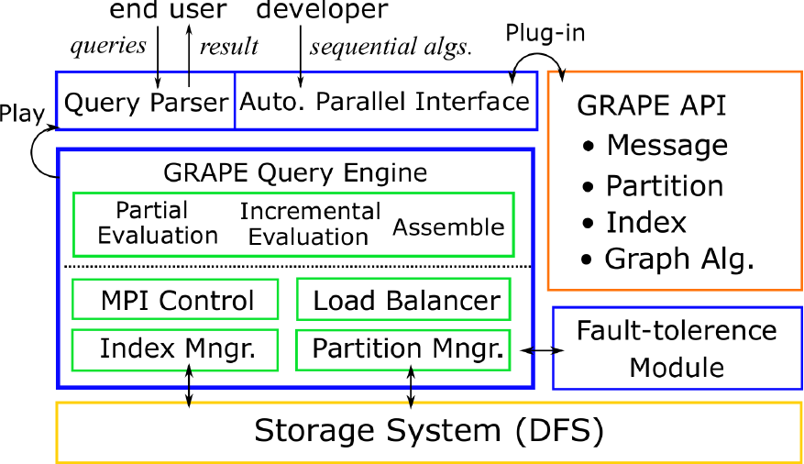
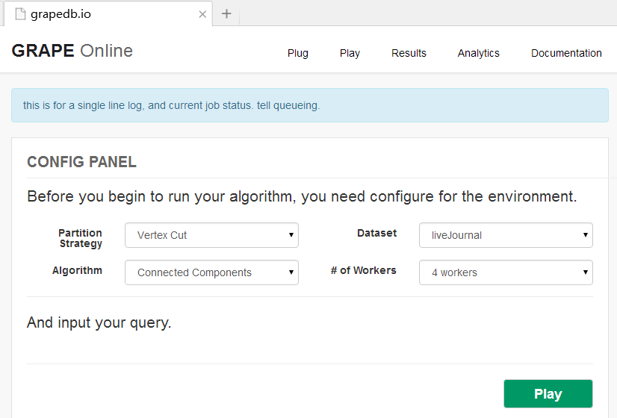
如四、GRAPE并发图数据查询引擎
分布式图计算引擎 (Pregel, GraphLAB, Giraph++, Blogel)
大量消息传递、缺乏全局优化能力等
编写困难，需要专家经验
大量图计算顺序算法被设计开发
顺序图计算算法的自动并发化
即插即用的图计算系统
华为共同用社交网络com-friendster数据集与2012年全互联网的网页连接图clueweb12做测试
验证了重要的图数据计算场景，如: k-hop问题等，可以在秒级时间内计算完成，并减少了冗余计算
获得数据库顶级会议SIGMOD2017最佳论文奖

Slide 43
Summary
Big Graph Search Challenges (FAE)
Big Graph Search Techniques (Query and Data Techniques)
Big Graph Search Techniques (Application Scenarios)
It remains a long way to go for Big Graph Search!

Slide 44






Acknowledgements
Collaborators:
Charu Aggarwal, Sourav S Bhowmick, Yang Cao, Gao Cong, Liang Duan, Wenfei Fan, Kaiyu Feng, Haixing Huang, Renjun Hu, Jinpeng Huai, Jia Li, Jianxin Li, Xuelian Lin, Xudong Liu, Jinghe Song, Haixun Wang, Luoshu Wang, Tianyu Wo…
They are from:

Slide 45
Homepage: http://mashuai.buaa.edu.cn
Email: mashuai@buaa.edu.cn
Address:
Room G1122,
New Main Building,
Beihang University
Beijing, China
Thanks!

